Slide 1
COMP90054 AI Planning for Autonomy Workshop Week 11
Ruixi
huor@student.unimelb.edu.au

Slide 2
Objectives
Game Theory
Three Auctions
1.English auction
2.Dutch auction
3.Vickrey auction(sealed-bid, second-price auction)
Pure Strategy
Mixed Strategy
Nash equilibrium
Notes:
Auctions are a classic example of game theory

Slide 3
I am selling 3 items by auction
Please write down how much do you value each item
$ 35
First item
$ 21
Second item
$ 52
Third item

Slide 4
First Item
$ 35
How much u value the first item
$ 21
$ 52

Slide 5
English Auction
The bidding starts at a price and bids are incremented until nobody wants to bid any higher. The winner is the person who bids the highest.
Start at $ 5

Slide 6
Second Item
$ 35
$ 21
How much u value the second item
$ 52

Slide 7
Dutch Auction
The bidding starts at a (presumably high value) and the auctioneer decrements the bids by a certain amount.
The first bidder to signal wins the auction at that price
Start at $ 120

Slide 8
Third Item
$ 35
$ 21
$ 52
How much u value the third item

Slide 9
Vickrey Auction
(sealed-bid, second-price auction)
Each bidder submits a single bid privately to the auctioneer, and the person with the highest bid wins.
However, they only pay what the price of the second-highest bid.

Slide 10
Outcome
The winner is the person who values the item the most

Slide 11
Comparison
if you pay more than anyone else in a market, then you must have overpaid, because you cannot possibly turn around and sell that item back to the same market for what you paid for it (otherwise someone else would have bid for it).
English Auction
The bidding starts at a price and bids are incremented until nobody wants to bid any higher. The winner is the person who bids the highest.
winner’s curse
Dutch Auction
The bidding starts at a (presumably high value) and the auctioneer decrements the bids by a certain amount. The first bidder to signal wins the auction at that price
Vickrey Auction
(sealed-bid, second-price auction)
Each bidder submits a single bid privately to the auctioneer, and the person with the highest bid wins. However, they only pay what the price of the second-highest bid.
You only pay the second-price, then you could (in theory) sell the item to the second-highest bidder for what you paid for it.

Slide 12
Pure Strategy
A single action is chosen

Slide 13
Strictly Dominant Strategy
Dominant strategies
Weakly Dominant Strategy
A dominant strategy for a player is one that produces the highest payoff of any strategy available for every possible action by the other players.
Prisoners’ Dilemma
What is the strategy of prisoner A?
B
If B admit, A should admit
Admit
Deny
-2, -2 | 0, -4
-4, 0 | -1, -1
A
Admit
Deny

Slide 14
Dominant strategies
A dominant strategy for a player is one that produces the highest payoff of any strategy available for every possible action by the other players.
Prisoners’ Dilemma
What is the strategy of prisoner A?
B
If B admit, A should admit
If B deny, A should admit
Admit
Deny
-2, -2 | 0, -4
-4, 0 | -1, -1
Admit is the strictly dominant strategy for A
A
Admit
Deny

Slide 15
Dominant strategies
A dominant strategy for a player is one that produces the highest payoff of any strategy available for every possible action by the other players.
Prisoners’ Dilemma
What is the strategy of prisoner A?
B
If B admit, A should admit
If B deny, A should admit
Admit
Deny
-2, -2 | 0, -4
-4, 0 | -1, -1
Admit is the strictly dominant strategy for A
A
Admit
What is the strategy of prisoner B?
If A admit, B should admit
Deny

Slide 16
Dominant strategies
A dominant strategy for a player is one that produces the highest payoff of any strategy available for every possible action by the other players.
Prisoners’ Dilemma
What is the strategy of prisoner A?
B
If B admit, A should admit
If B deny, A should admit
Admit
Deny
-2, -2 | 0, -4
-4, 0 | -1, -1
Admit is the strictly dominant strategy for A
A
Admit
What is the strategy of prisoner B?
If A admit, B should admit
Deny
If A deny, B should admit
Admit is the strictly dominant strategy for B

Slide 17
Nash equilibrium (pure strategy)
A profile of strategies such that each player’s strategy is a best response
Property: stable
If each player expects action a to be the profile of actions played, then no player has any incentive to change his or her action assuming the other player don’t change strategy.
Nash equilibrium = (A admit, B admit)
B
Admit
Deny
In other words, no player regrets having played the action that he or she played in a Nash equilibrium
-2, -2 | 0, -4
-4, 0 | -1, -1
A
Admit
Deny
Notes:
A Nash equilibrium has the nice property that it is stable

Slide 18
Nash equilibrium (pure strategy)
A profile of strategies such that each player’s strategy is a best response
Property: stable
If each player expects action a to be the profile of actions played, then no player has any incentive to change his or her action assuming the other player don’t change strategy.
Nash equilibrium = (A admit, B admit)
B
Admit
Deny
In other words, no player regrets having played the action that he or she played in a Nash equilibrium
-2, -2 | 0, -4
-4, 0 | -1, -1
A
Admit
Question:
If B doesn’t change his action (admit),
will A regret his decision (admit) ?
No
Deny
Notes:
Q1: for A, -4 is smaller than -2, so A doesn’t regret his decision.

Slide 19
Nash equilibrium (pure strategy)
A profile of strategies such that each player’s strategy is a best response
Property: stable
If each player expects action a to be the profile of actions played, then no player has any incentive to change his or her action assuming the other player don’t change strategy.
Nash equilibrium = (A admit, B admit)
B
Admit
Deny
In other words, no player regrets having played the action that he or she played in a Nash equilibrium
-2, -2 | 0, -4
-4, 0 | -1, -1
A
Admit
Question:
If B doesn’t change his action (admit),
will A regret his decision (admit) ?
No
Deny
Question:
If A doesn’t change his action (admit),
will B regret his decision (admit) ?
No
Notes:
Q2: for B, -4 is smaller than -2, so B doesn’t regret his decision.

Slide 20
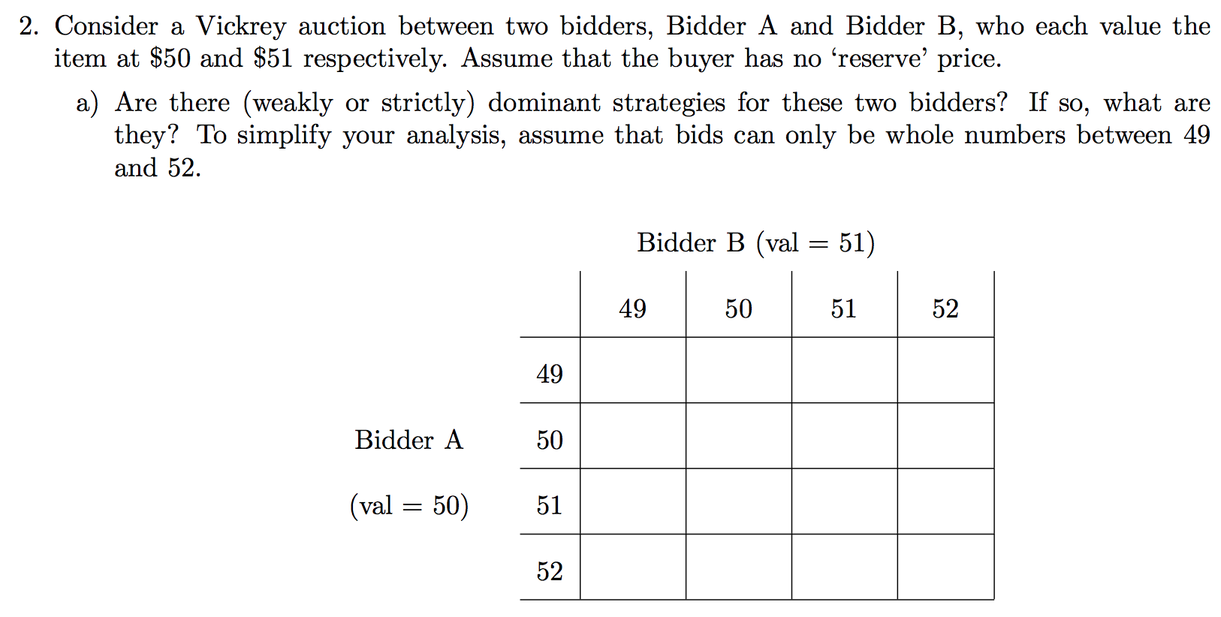
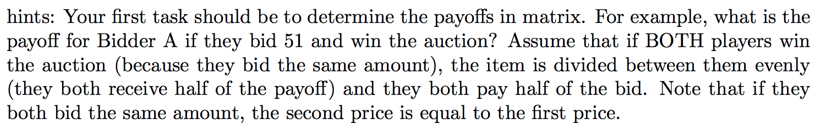
A bids 49, B bids 50
B will win, B will pay 49 to buy it
B values it at 51
So the payoff of B is 51-49 = 2
(0, 2)

Slide 21
(0, 2)
(0, 2)
(0, 2)

Slide 22
(0, 2)
(0, 2)
(0, 2)
(0, 1)
(0, 1)

Slide 23
(0, 2)
(0, 2)
(0, 2)
(1, 0)
(0, 1)
(0, 1)
(1, 0)
(0, 0)
(0, 0)
(1, 0)
(0, 0)
(-1, 0)

Slide 24
49/2 = 24.5
For A: payoff = 50/2 – 49/2 = 0.5
For B: payoff = 51/2 – 49/2 = 1
(0.5, 1)
(0, 2)
(0, 2)
(0, 2)
(1, 0)
(0, 0.5)
(0, 1)
(0, 1)
(1, 0)
(0, 0)
(-0.5, 0)
(0, 0)
(1, 0)
(0, 0)
(-1, 0)
(-1, -0.5)

Slide 25
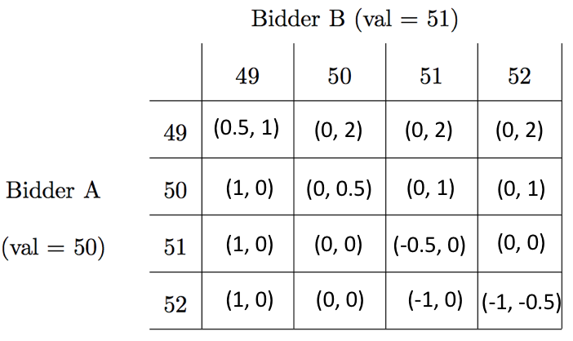
Strictly Dominant Strategy
Dominant strategies
Weakly Dominant Strategy
For A
If B plays 49, then A should play 50, 51, 52
If B plays 50, then A should play any strategy
If B plays 51, then A should play 49, 50
If B plays 52, then A should play 49, 50, 51
So, 50 is the weakly dominant strategy for A

Slide 26
Strictly Dominant Strategy
Dominant strategies
Weakly Dominant Strategy
For A
If B plays 49, then A should play 50, 51, 52
If B plays 50, then A should play any strategy
If B plays 51, then A should play 49, 50
If B plays 52, then A should play 49, 50, 51
So, 50 is the weakly dominant strategy for A
For B
If A plays 49, then B should play 50, 51, 52
Question: What is the Nash equilibrium?
If A plays 50, then B should play 51, 52
Clearly, the combination of the two weakly dominant strategies is one equilibrium, but are their others?
If A plays 51, then B should play any strategy
If A plays 52, then B should play49, 50, 51
There are 10 equilibrium
So, 51 is the weakly dominant strategy for B

Slide 27
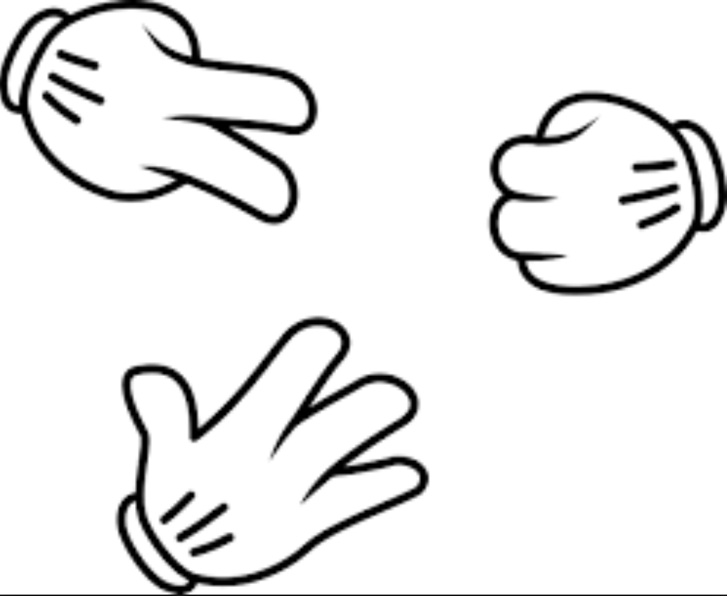
Mixed Strategy
e.g. paper scissors rock
If each time, I just play rock no matter what the other player plays
Pure Strategy
If each time, I play 50% paper, 20% scissors, 30% rock
Mixed Strategy

Slide 28
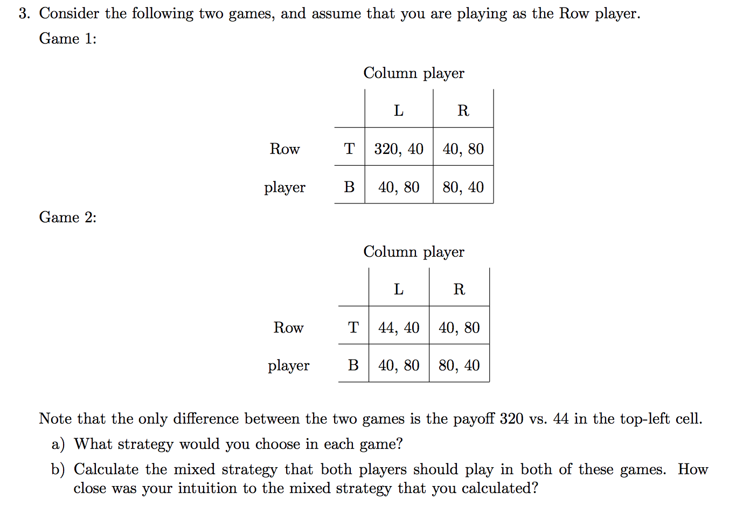
What is the strategy of Row Player?
If Column player L, Row should T
If Column player R, Row should B
So, there is no pure strategy for Row Player
What is the strategy of Column Player?
If Row player T, Column should R
If Row player B, Column should L
So, there is no pure strategy for Column Player
Mixed Strategy

Slide 29
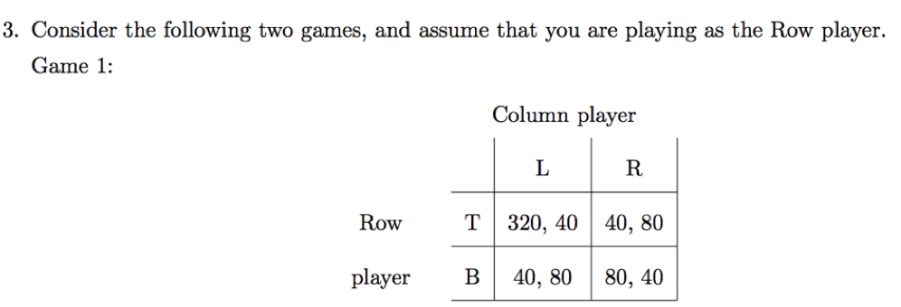
Mixed Strategy
For a player, how to identify the probability of each action?
Indifference Principle
Now let's suppose player 2 plays a mixed strategy which makes player 1 indifferent.
In such a condition no matter what player 1 plays, any strategy by player 1 would be termed as a Best Response.
This is because payoffs are equal for all strategies for player 1.
Notes:
So player 1 won’t be able to aim at player 2.

Slide 30
X
1-X
What is the mix strategy of Row Player?
In order to make Column player indifference
(payoffs are equal for all strategies for Column player)
L
E(L) = 40*X + 80*(1-X)
R

Slide 31
X
1-X
What is the mix strategy of Row Player?
In order to make Column player indifference
payoffs are equal for all strategies for Column player
L
E(L) = 40*X + 80*(1-X)
E(I) =E(R)
R
E(R) = 80*X + 40*(1-X)
X = 1/2
So, mixed strategy for Row player is 1/2 T, 1/2 B

Slide 32
Y
1-Y
What is the mix strategy of Column Player?
In order to make Row player indifference
payoffs are equal for all strategies for Row player
T
E(T) = 320*Y + 40*(1-Y)
E(T) =E(B)
B
E(B) = 40*Y + 80*(1-Y)
Y = 1/8
So, mixed strategy for Column player is 1/8 L, 7/8 R

Slide 33
Mixed strategy for Row player is 1/2 T, 1/2 B
Mixed strategy for Column player is 1/8 L, 7/8 R
There is no pure Nash equilibrium
The mixed Nash equilibrium is ( (Row player 1/2 T, 1/2 B) , (Column player 1/8 L, 7/8 R) )

Slide 34
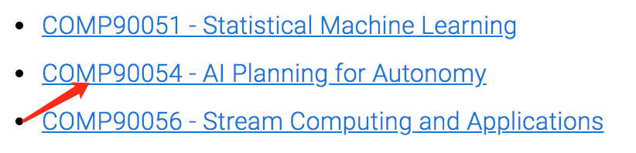
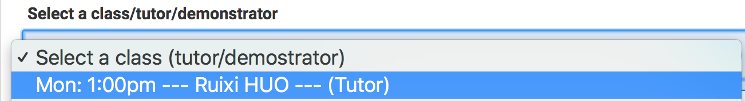
Fill in the survey
https://apps.eng.unimelb.edu.au/casmas/index.php?r=qoct/subjects

